Slide 1
Tree
Course Code: CSC 2106
Course Title: Data Structure (Theory)
Dept. of Computer Science
Faculty of Science and Technology
Lecturer No: | 9.1 | Week No: | 9 | Semester:
Lecturer: | Name & email

Slide 2
Lecture Outline
Tree
Basic Terminology
Binary Tree
  Complete Binary Tree
  Full Binary Tree
  Balanced Tree
  Tree Traversal

Slide 3
Tree
Introduction
Many applications are hierarchical in nature.
Linear data structures are not appropriate for these type of applications.
President
Vice President
Vice President
Vice President
Executive
Executive
Executive
Executive
Executive

Slide 4
Tree
Some Applications
Representing hierarchical data
Storing data in a way that makes it easily searchable
Representing sorted lists of data
Routing algorithms

Slide 5
Tree
Definition
As a data structure, a tree consists of one or more nodes, where each node has a value and a list of references to other (its children) nodes.
A tree must have a node designated as root. If a tree has only one node, that node is the root node. Root is never referenced by any other node.
Having more than one node indicates that the root have some (at least one) references to its children nodes and the children nodes (might) have references to their children nodes and so on.

Slide 6
Tree
An example
VALUE
ROOT
A
CHILD
CHILD
B
C
D
E
F
G
H
I
J
K
L
M
N
O

Slide 7
Tree
Terminologies
As a data structure, a tree consists of one or more nodes, where each node has a value and a list of references to other (its children) nodes.
A tree must have a node designated as root. If a tree has only one node, that node is the root node. Root is never referenced by any other node.
Having more than one node indicates that the root have some (at least one) references to its children nodes and the children nodes (might) have references to their children nodes and so on.

Slide 8
Tree
Definition
A
Generally it is considered that in a tree, there is only one path going from one node to another node.
There cannot be any cycle or loop.
The link from a node to other node is called an edge.
An arrowed edge indicates flow from P to Q.
An straight line edge indicates flow from P to Q and Q to P.
B
C
D
E
F
G
H
I
J
P
Q
Q
K
L
M
N
O
P
If node F is reached through node B, than the link from node K to node F will not be considered.
If link from node L to node C is considered, than there will be a cycle among nodes C, G, and L.
A straight line is generally used to represent the links between the nodes of a tree.

Slide 9
Tree
Terminologies
Nodes
Parent Nodes & Child Nodes
Leaf Nodes: nodes with no child
Root Node: node with no parent
Sub Tree: the tree rooted by a child
Level of a tree:
  Root at level 0;
  Each children have the level one more than its parent.
Height/depth of the tree: Total number of Levels
Height of a node: Total number of levels from bottom
[Tree height – node level].
LEVEL
A
0
1
B
C
D
E
H
I
J
2
F
G
Height of root A is 4;
Height of nodes B, C, D is 3;
Height of E, F, G, H, I, J is 2;
Height of nodes K, L , M, N, O is 1.
3
K
L
M
N
O
Height of this tree is 4, as there are four levels (0…3).

Slide 10
Tree
m-ary tree
A Tree is an m-ary Tree when each of its node has no more than m children.
A
A
3-ary tree
B
D
C
D
E
F
H
I
B
G
H
I
J
K
G
N
O
E
F
L
M
2-ary tree
K
L
M
N
O

Slide 11
Binary Tree
Definition and example
A
Each node of a binary Tree has at most 2 children.
B
D
E
F
H
I
K
G
N
O
L
M
Binary tree

Slide 12
Complete and Full Binary Tree
A complete/full binary tree is a binary tree, which is completely filled with nodes from top to bottom and left to right.
The tree starts from the root (top), goes to the next level with first the left child and then the right child (left to right). The process repeats for each next level with each node till the last (bottom) level.
In complete binary tree some of the nodes only for the bottom level might be absent (here nodes after N).
In Full binary tree the last/bottom level must also be filled up.
A
B
D
E
F
H
I
K
L
G
M
N
C
J
P

Slide 13
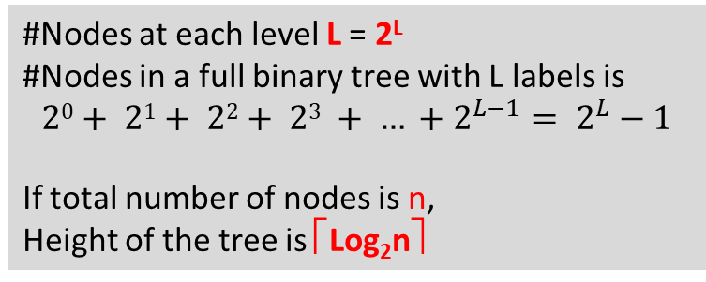
Full Binary Tree
#Nodes at each level L = 2^{L}
#Nodes in a full binary tree with L labels is
$$20+ 21+ 22+ 23 + … +2^{L−1}= 2^{L}−1$$
If total number of nodes is n,
Height of the tree is ⎡Log₂n⎤
Level=0,
# of nodes=2⁰=1
A
Level=1,
# of nodes=2¹=2
B
D
Level=2,
# of nodes=2²=4
E
F
H
I
Level=3,
# of nodes=2³=8
K
L
G
M
N
C
J
P

Slide 14
Complete Binary Tree
Exercise
A full binary tree is always a complete binary tree but vice versa may not be true. Why?
A complete binary tree has L labels. How many nodes it may have in both minimum and maximum cases?
A complete binary tree has L labels. At most, how many more nodes are required to make it a full binary tree?

Slide 15
Tree Traversal
Introduction
Systematic way of visiting all the nodes.
Methods:
  Inorder
  Preorder
  Postorder
They all traverse the left subtree before the right subtree.

Slide 16
Tree Traversal
Inorder
D
B
A
A
E
F
B
H
D
E
F
K
L
M
C
H
K
L
M
C

Slide 17
Tree Traversal
Inorder
E
B
F
A
D
K
L
E
F
M
H
K
L
M
C

Slide 18
Tree Traversal
Inorder
K
E
L
B
F
M
A
H
D
C
K
L
M
H
C

Slide 19
Tree Traversal
Inorder
K
E
L
B
F
M
A
H
C
D
C

Slide 20
Tree Traversal
Inorder
Traversing order
left subtree
parent
right subtree
A
B
D
E
F
H
K
L
M
C
K
E
L
B
F
M
A
H
C
D

Slide 21
Tree Traversal
Preorder
Traversing order
parent
left subtree
right subtree
A
B
D
E
F
H
K
L
M
C
A
B
E
K
L
F
M
D
H
C

Slide 22
Tree Traversal
Postorder
Traversing order
left subtree
right subtree
parent
A
B
D
E
F
H
K
L
M
C
K
L
E
M
F
B
C
H
D
A

Slide 23
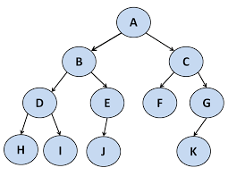
Tree Traversal
Exercise
Visit the tree
Inorder
Preorder
Postorder

Slide 24
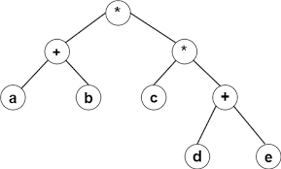
Tree Traversal
Exercise
Visit the tree
Inorder
Preorder
Postorder

Slide 25
References
https://en.wikipedia.org/wiki/Binary_Search_Tree

Slide 26
Books
“Schaum's Outline of Data Structures with C++”. By John R. Hubbard
“Data Structures and Program Design”, Robert L. Kruse, 3rd Edition, 1996.
“Data structures, algorithms and performance”, D. Wood, Addison-Wesley, 1993
“Advanced Data Structures”, Peter Brass, Cambridge University Press, 2008
“Data Structures and Algorithm Analysis”, Edition 3.2 (C++ Version), Clifford A. Shaffer, Virginia Tech, Blacksburg, VA 24061 January 2, 2012
“C++ Data Structures”, Nell Dale and David Teague, Jones and Bartlett Publishers, 2001.
“Data Structures and Algorithms with Object-Oriented Design Patterns in C++”, Bruno R. Preiss,

